Slide 1

Participating In The Data Control Convergathon
A Data Control Convergence Event in Berlin
opennotice.legalhackathon.org

Slide 2
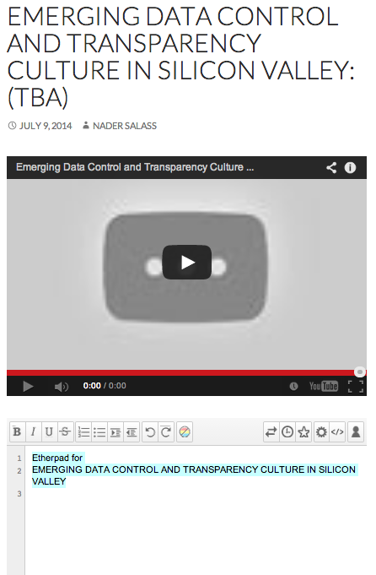
Virtual Venue Template
Macintosh HD
→ Google Hangout
→ Ether Pad
Virtual Venue Brought To You By…
MIT Human Dynamics Lab
Legal Research Team

Slide 3
How To Register
Get Tickets Here:
opennotice.legalhackathon.org/tickets

Slide 4
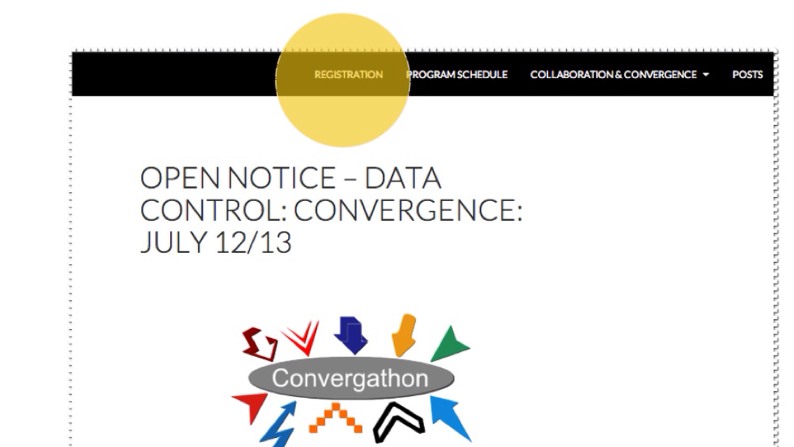

Slide 5
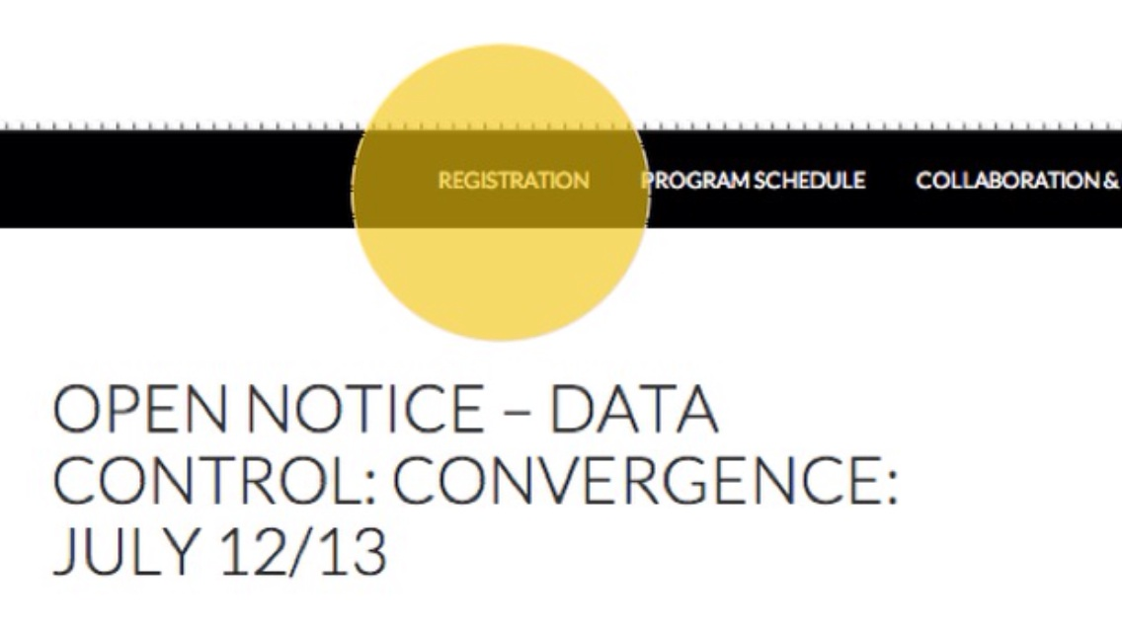

Slide 6



This Event Is Brought To You By,..
Sponsors
Collaborators

